Slide 1


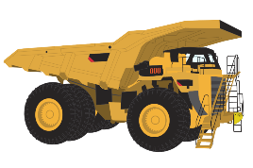
Project 2
Interactive mining INCIDENT dashboard
By Grant Towers and Nicholas Mcmahon

Slide 2

Contents
Data Story/Sourcing
ETL Process
Dashboard
Visualization 1 – Mine Details Data Tablet
Visualization 2 – Dual Dataset Injury Donut
Visualization 3 – Stacked Bar Incident Activities by Month
Visualization 4 – Bar Chart of Incidents By Category

Slide 3
Data Story
Then…
Now…
The Safety Team requested a new database for storage and query (as required), of U.S. regulator (external) incident data from 2020. (AKA our ETL Project…)
This database allowed the team to complete a review.
The Executive Team would now like to visualise the key incident data for the 20 mining companies that had the highest number of incidents.
Knowing that the same data is released each year, the Safety Team has asked for our specific set of skills once again…
The objective… Build a dashboard that can be used (then refreshed each year), just by updating the source data in a folder location.

Slide 4
ETL Process
As mentioned, we completed part one of this project as part of the previous ETL Project:
Data Summary:
5,332 incidents across 2020 (Contains Incident, Injury and Company Data),
Fairly Basic Data Collection (many options – minimal free text)
ETL Steps Required:
Dropped many columns (irrelevant, dirty or useless data)
No single event ID, only ID was mine_id (unable to link incidents once separated into tables)
We had to do more data transformation (injury nature/body part as well as filter to only top 20 mines)

Slide 5
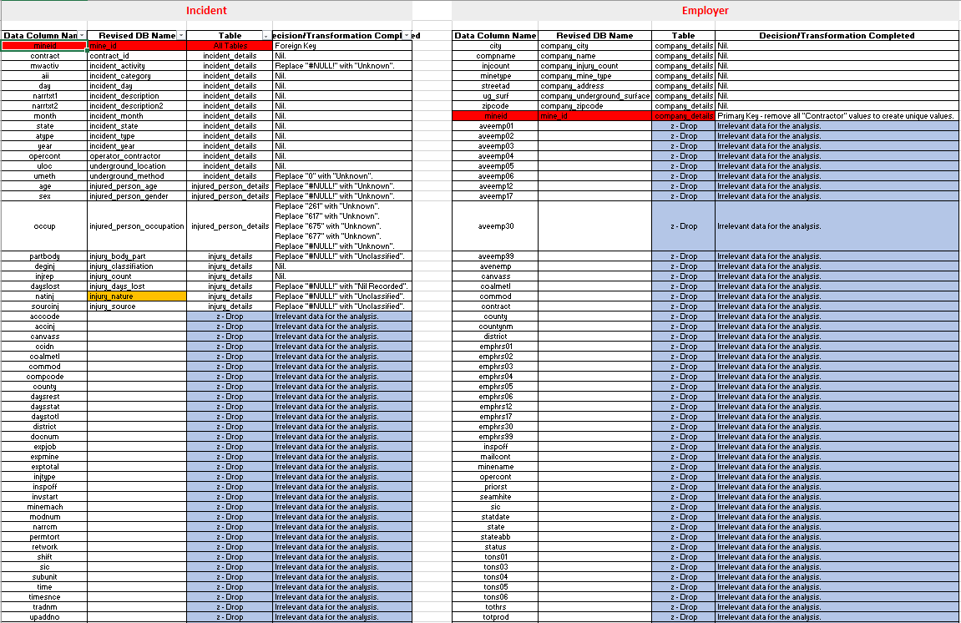
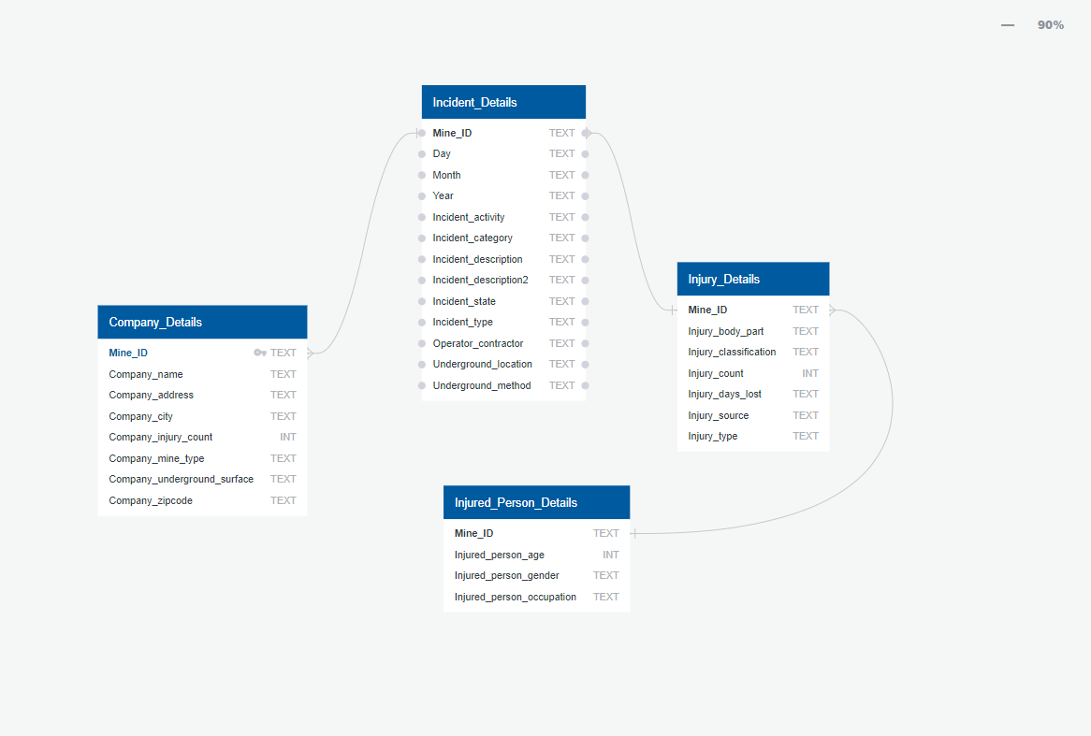
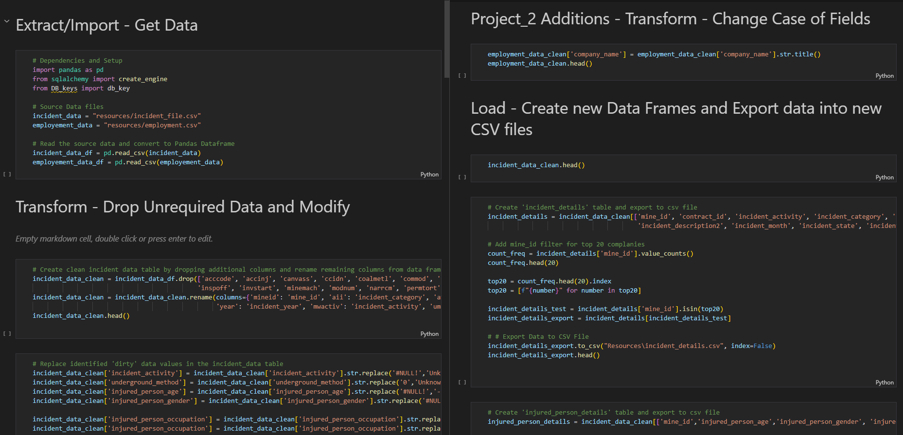
ETL Process
Data Sourcing and Extraction
Source data from https://www.cdc.gov/niosh/mining/data/ and download relevant CSV datasets
Using Excel and http://www.quickdatabasediagrams.com we dissected the tables and produced a schema
Transformation of Data
Import all Dependencies and setup CSV Panda reads.
Create clean incident/employment data table by dropping additional columns and rename remaining columns from data frames.
Loading Data
Create Incident_data Database in Postgres pgAdmin4
Create the four tables as seen in the image to the left.
Replace identified 'dirty' data values in the incident_data table.
Group and count the Top 20 Mine sites and filter tables to only include those.
Create a database connection to postgres and Load data into tables.

Slide 6
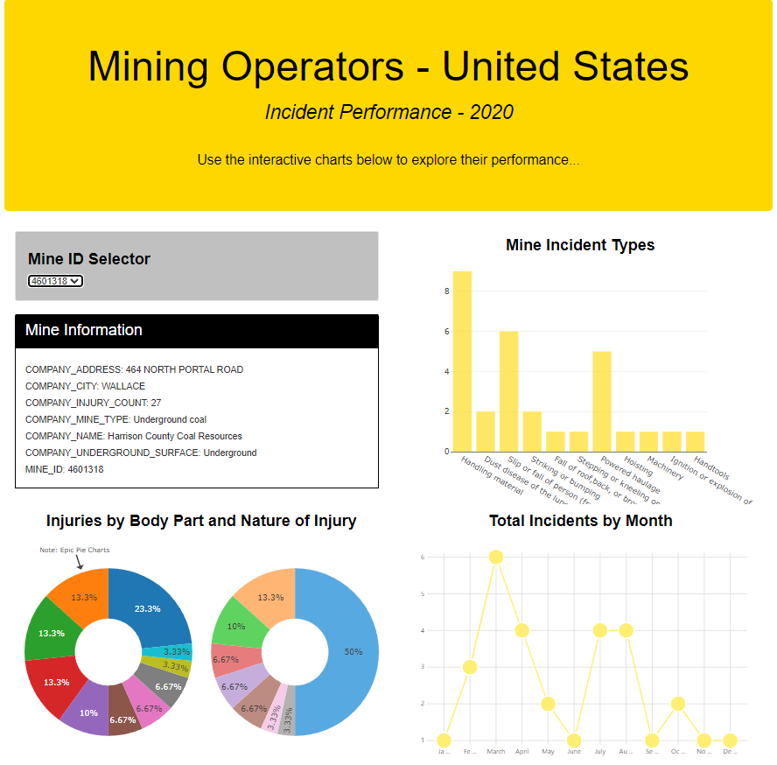
Dashboard
Current Dashboard Interactivity Options:
Able to filter results by the Mine ID Selector.
If we had more time…
More Visualisations
More Filters – by Underground/Surface, Commodity etc.

Slide 7
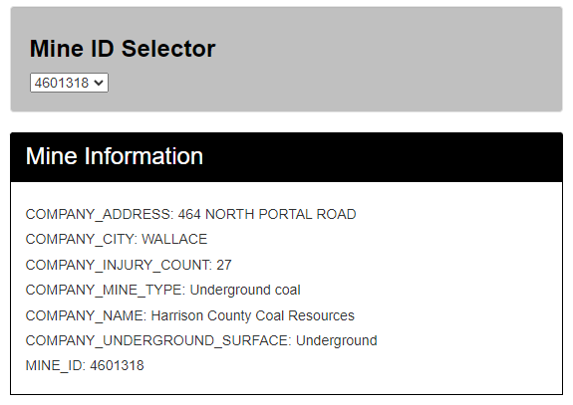
Visualization 1 Mine Information Overview Data: Imported using the mine_id, importing an overview of the Mines information as shown. Visualisation Source: - Generated using plot.ly - Uses the mine_id and the company_details table.

Slide 8
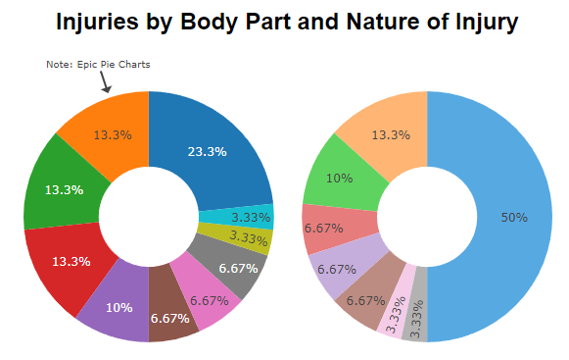
Visualization 2 Dual Dataset Injury Donut Data: Using the mine_id, selected, it filters the injury_data table to present a summary of injuries by Body Party and Nature. Visualisation Source: - Generated using plot.ly - Uses the injury_data table

Slide 9
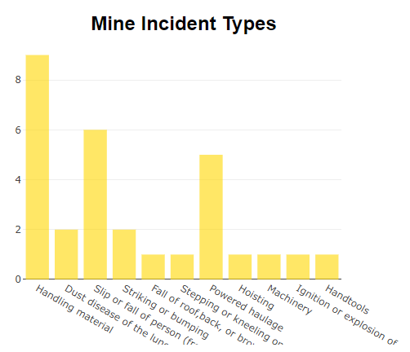
Visualization 3 Incidents by Type Data: Using the mine_id, selected, it filters the incident_data table to present a summary of incidents by ‘Type’. Visualisation Source: - Generated using plot.ly - Uses the incident_details table

Slide 10
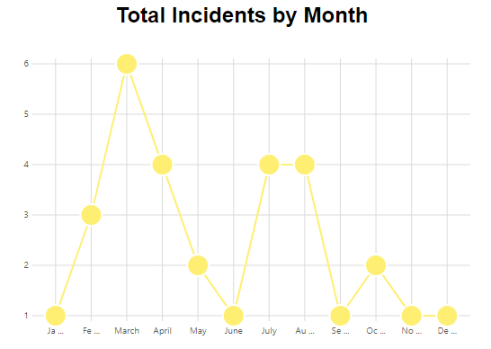
Visualization 4 Incidents Counts by Month Data: Using the mine_id, selected, it filters the incident_data table to present a summary of incidents which occurred each month. Visualisation Source: - Generated using Frappe.Charts (https://frappe.io/charts) - Uses the incident_details table

Slide 11


Thankyou for listening
Stay safe out there!

